Slide 1
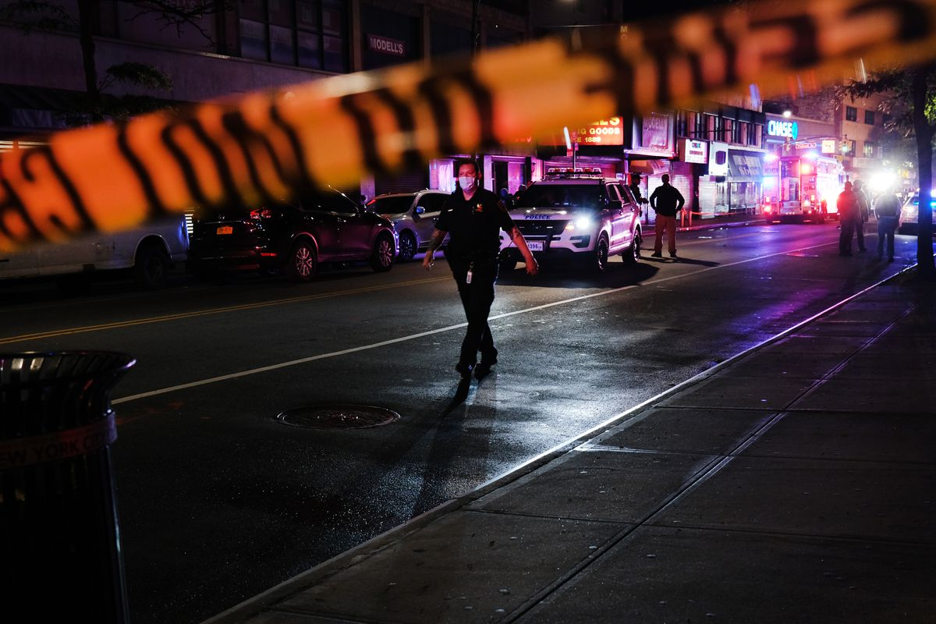
Exploring crime trends in Los Angeles: An analysis of recent data
By
Bindhu Lasya

Slide 2
Understanding crime incidents in Los Angeles
Purpose: To gain insights into crime incidents in Los Angeles over the past year and a half.
Importance: By analyzing crime incidents, we can identify patterns and trends that can help inform public policy and resource allocation to prevent and reduce crime.
Scope: The analysis covers a variety of crime types, locations, and time periods to provide a comprehensive overview of crime incidents in Los Angeles.
Goals: The goals of the analysis are to identify the top crime types and locations, the most frequent days for crimes, the areas with the highest crime rates, and the trends in crime incidents over time.
Approach: The analysis takes a data-driven approach to understanding crime in Los Angeles, relying on empirical evidence rather than assumptions or anecdotes

Slide 3
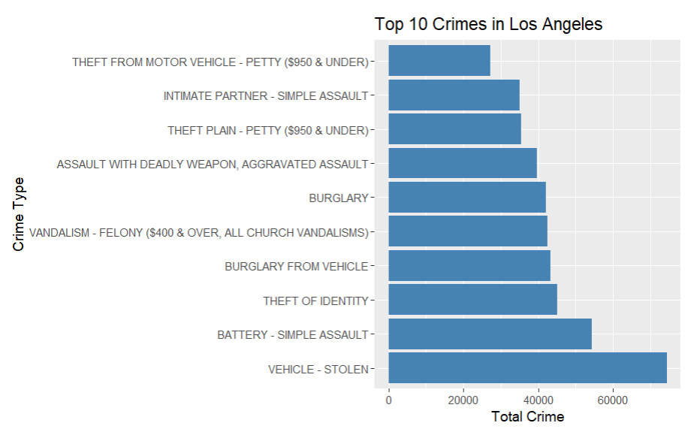
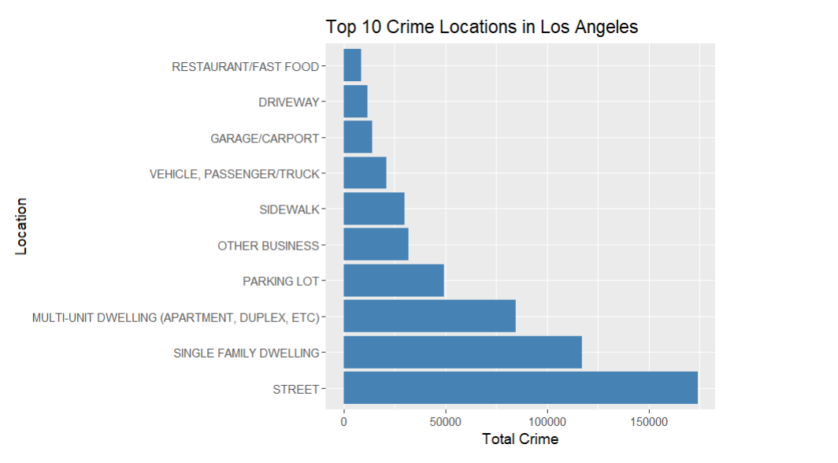
Crime by type and Location
The top 10 crime types in Los Angeles were plotted in the graph. The highest Crime is Vehicle Stolen and Battery Simple Assault.
The top 10 locations with the highest number of crimes plotted in the graph. The graph shows that the most common locations for crimes in Los Angeles were streets, apartments, and parking lots.

Slide 4
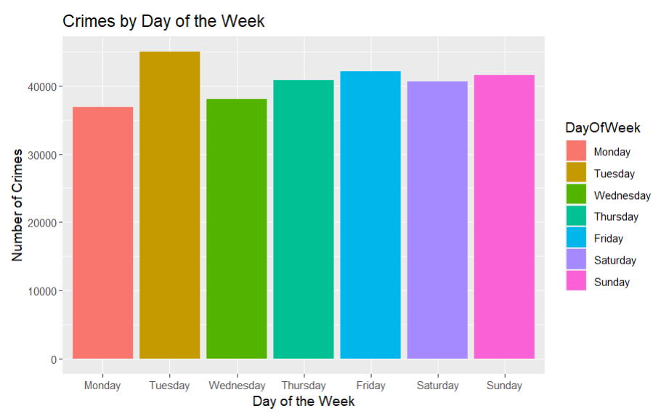
Crimes by day of the week
The resulting bar chart shows that crimes are most frequent on Tuesdays, followed by Friday and Saturdays, while Mondays and Wednesdays have the lowest number of reported crimes.

Slide 5
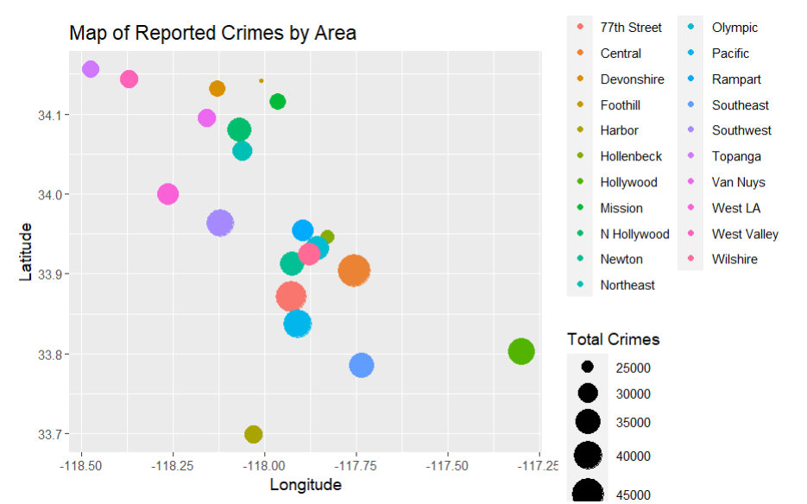
Differences in crime rates across different parts of the city
The scatter plot shows that areas with higher crime rates. The plot reveals that certain areas such as Central and South Los Angeles have higher crime rates compared to other areas such as Pacific and West Los Angeles.

Slide 6
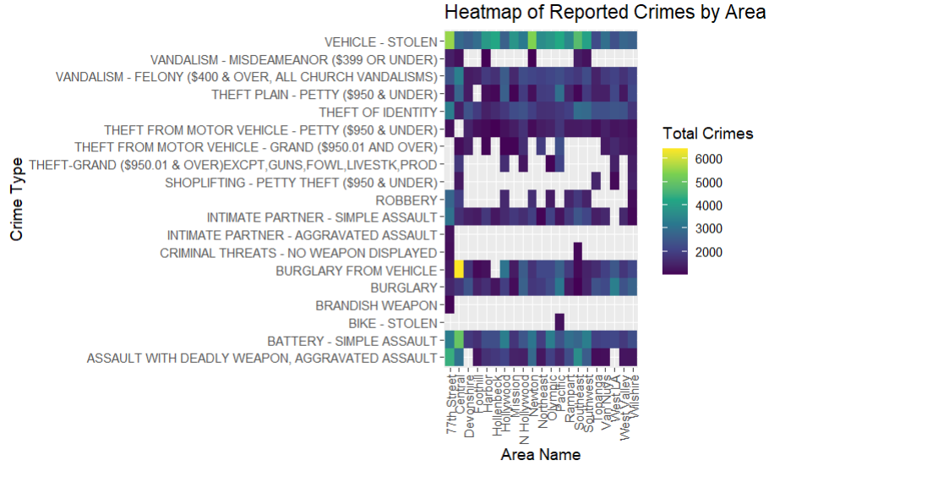
Identifying any outliers or unusual patterns in the data

Slide 7
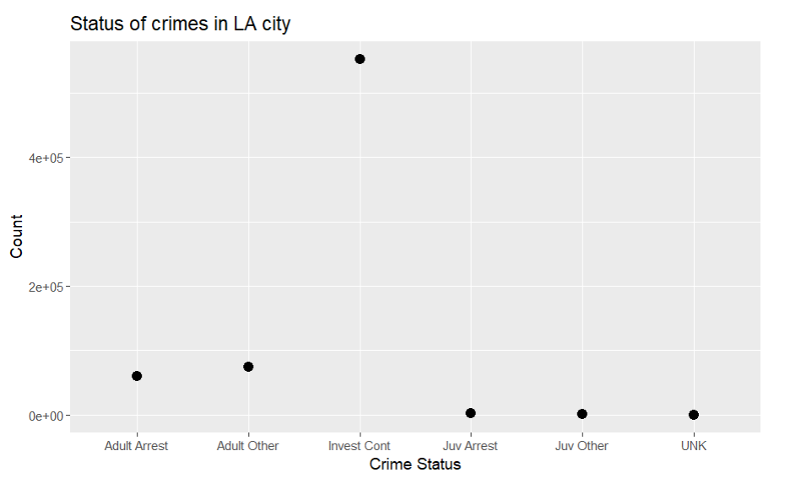
Status of each crime
The general idea of how many crimes have been resolved and how many are still being investigated or remain unsolved. Here we can see there are more number cases that are under investigation.

Slide 8
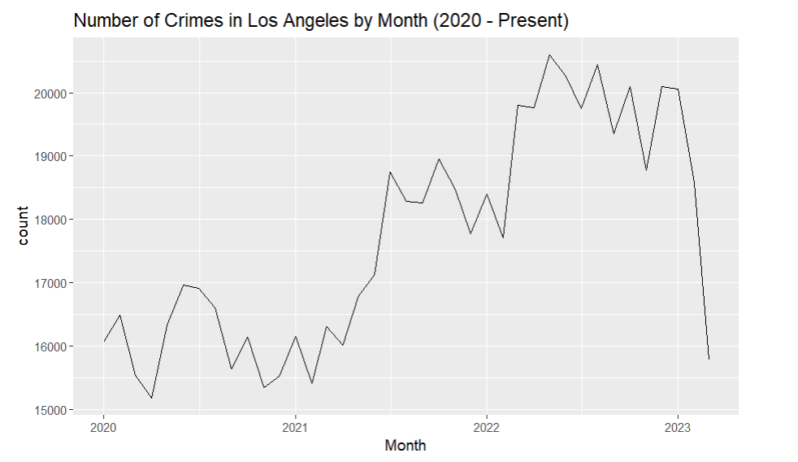
Number of crimes In each month
We can see that crime levels have fluctuated over time, with a peak in mid-2020, followed by a steady decline in the latter part of 2020 and early 2021. However, there has been a gradual increase in the number of crimes reported since mid-2021, indicating that crime levels may be on the rise again.

Slide 9
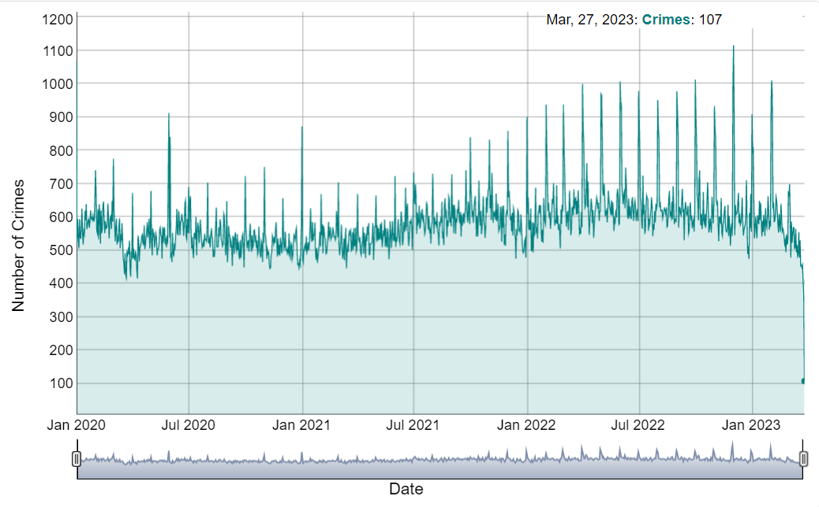
Crimes by date and number of occurrences for each date.
This analysis only looks at the number of reported incidents and does not consider unreported crimes or changes in reporting behavior.

Slide 10
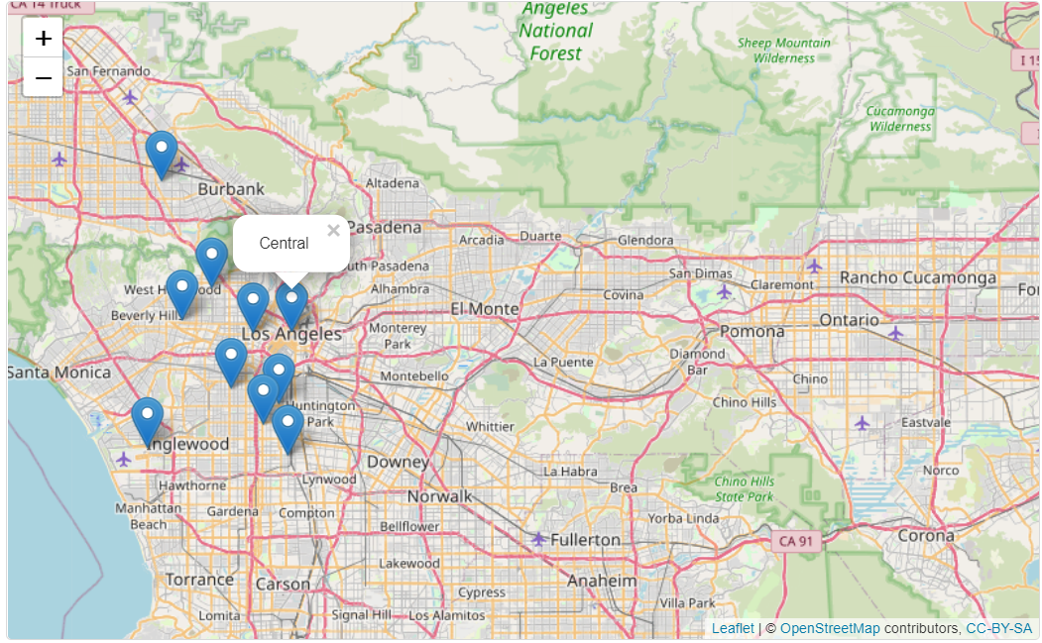
Top 10 areas with the highest crime rates in Los Angeles
The area with the highest crime rate in Los Angeles is Central with 46118 crimes and the lowest crime rate is Wilshire with 32542 crimes.

Slide 11
Conclusion
Based on the different analyses conducted, it can be concluded that there are specific crime types, locations, days of the week, and areas in Los Angeles that have a higher frequency of reported crimes. Law enforcement agencies and policymakers can use this information to implement targeted interventions and prevention strategies to reduce crime rates in the city.
Overall, this analysis provides valuable insights into the distribution of crime in Los Angeles and can serve as a foundation for future research and policy decisions to enhance public safety in the city.

Slide 12
Future scope
The further analysis for this analysis will be Demographic Analysis.
Analyzing the demographic data available in the dataset could provide insights into the disparities and patterns in the involvement of different races, ethnicities, and genders in various types of crimes. By examining this information, we could potentially uncover patterns that may help address issues related to social justice and inequality.
For example, we could explore whether certain races or ethnicities are overrepresented as victims or suspects in particular types of crimes. We could also investigate whether there are any gender-based disparities in the commission or victimization of certain crimes. By analyzing this data, we could potentially identify any biases or injustices in the criminal justice system and work towards addressing them.

Slide 13


